Slide 1

Building Bots for Microsoft Teams
Shantha Kumar Thambidurai
@ktskumar | C# Corner MVP | www.ktskumar.com
Jayanthi P
@JayanthiP | C# Corner MVP

Slide 2
Agenda
Bot Framework
Azure Bot Service
Cognitive Services
Deploying intelligent Bots into Teams
Demo

Slide 3








What is Bot Framework?
Bot Connector Service
Chat Bot API
Bot Builder SDK
Other Services

Slide 4
Azure Bot Service
Speeds up development by providing an integrated environment
Get started in seconds with out-of-the-box templates for scenarios including
Basic,
Form,
Language understanding,
Question and Answer, and
Proactive bots.

Slide 5

QnA Maker
Respond to user's questions in a more natural, conversational way.
Build, train and publish a simple question and answer bot based on FAQ URLs, structured documents, product manuals or editorial content in minutes.

Slide 6

LUIS
Language Understanding (LUIS) allows your application to understand what a person wants in their own words
LUIS uses machine learning to allow developers to build applications that can receive user input in natural language and extract meaning from it

Slide 7

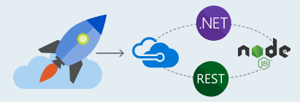

Deploying Bots to Microsoft Teams
Design a great bot
Be responsive – respond to messages and events
Recognize and respond to questions and non-questions
Have a personality
Develop your bot
Bot Builder SDK for .NET
Bot Builder SDK for Node.js
Register and deploy your bot
Get a Bot ID and App ID/Secret and configure bot
Make sure bot is reachable from the internet
Enable analytics

Slide 8
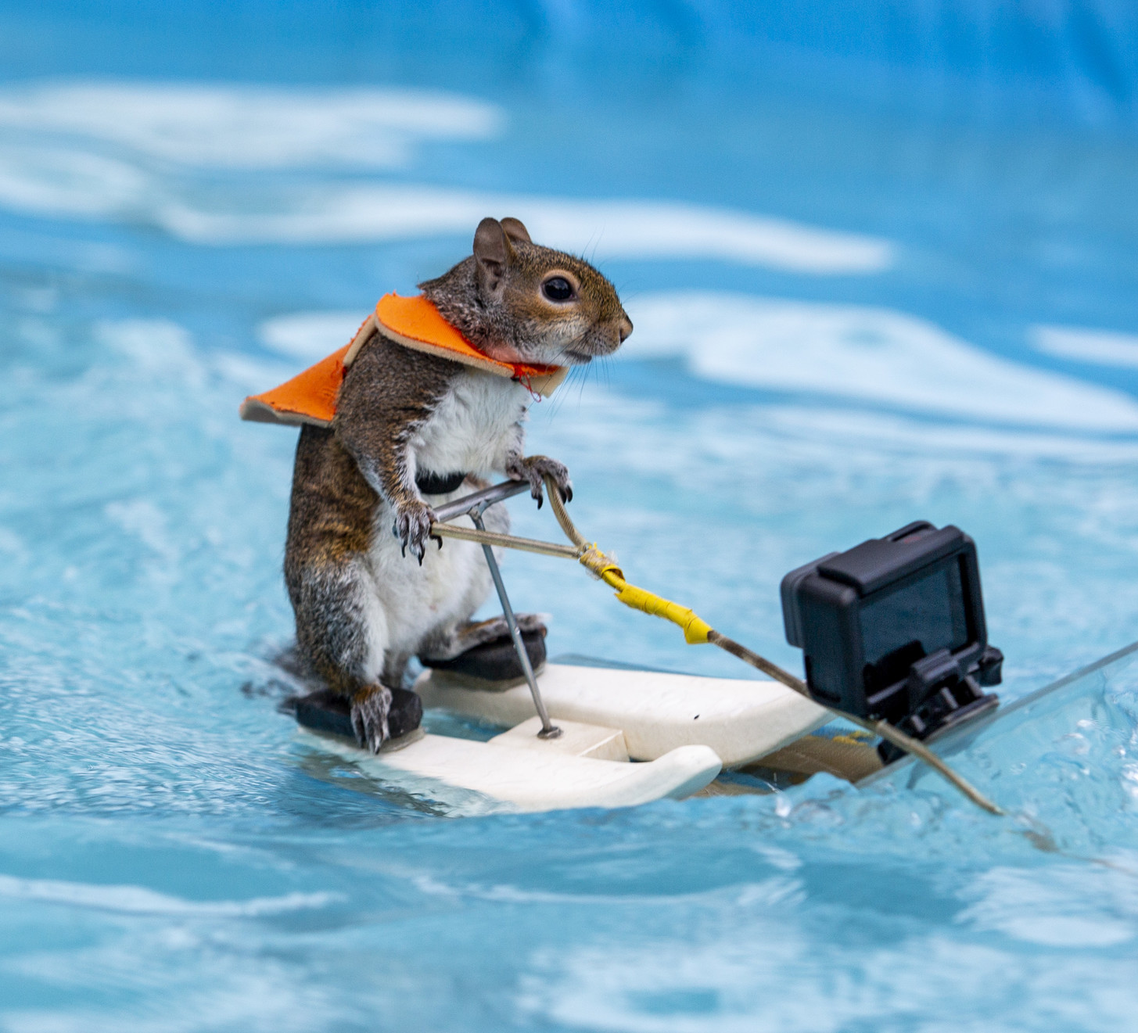
Lets Get into Action

Slide 9
Prerequisites
Sign up for a free trial Azure Subscription
https://azure.microsoft.com/en-us/free/
Visual Studio 2015 or higher
Bot Builder SDK V4 Template
Bot Emulator
https://github.com/Microsoft/BotFramework-Emulator/releases
Microsoft Teams
https://teams.microsoft.com/downloads

Slide 10
Demo
Building Intelligent Bot using LUIS, QnA Maker and Azure Bot Service
1
Bot Integration with Microsoft Teams
2
Create a Bot Locally with the Bot Builder SDK V4 and Testing with Emulator
3

Slide 11
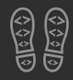
Enjoy the Bootcamp

Slide 12

Call to action
(Recommendation to Bootcamp organizers and speakers: This slide can be used at the end of the Bootcamp to have attendees to fill online feedback form and recommendation for their ongoing learning and app development on Office 365 platform. Please keep the first three bullet points, you can update the last bullet point to be the user group or community that you are leading that you’d like attendees to join and learn more. Please keep the first feedback bullet point at the top and feel free to re-arrange the rest of bullet point orders. Thanks.
Share your feedback on Bootcamp at https://aka.ms/o365devbootcampfeedback
Join Office 365 developer program https://dev.office.com/devprogram to leverage all resources for Office 365 development learning
Build applications on Office 365 platform
Attend MVP led local community events to continue learning on Office 365 development

Slide 13

☺
THANK YOU

